Slide 1


In The Name Of GOD

Slide 2
Potassium
&
Hypertension
F.Saddadi M.D
Nephrologist
HKC
IUMS
1402-2-28

Slide 3
Out Lines
1-Introduction to POTASSIUM and its vascular effect
2- Dietary intake of potassium
3- The ratio of dietary sodium-to-potassium
4-Clinical implications
5- Dietary sodium excess
6-Take Home Messages

Slide 4
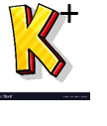
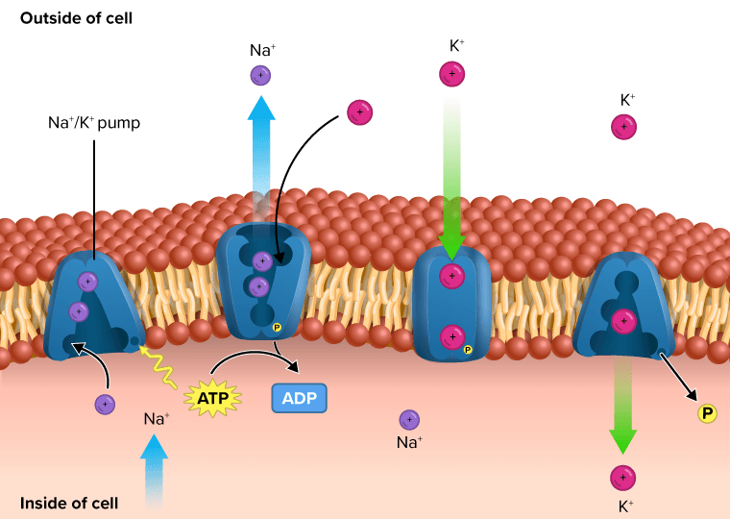
Introduction
POTASSIUM and its vascular effect
Na+-K+- ATPase
IS THE MOST ABUNDANT intracellular ion,
the pump NA+K+ATPase
is the active transport system
maintenance of the transmembrane gradients of Na+ and K+.
Provide energy for several essential cellular functions
control of membrane potential
cell volume
pH

Slide 5
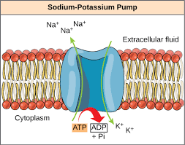
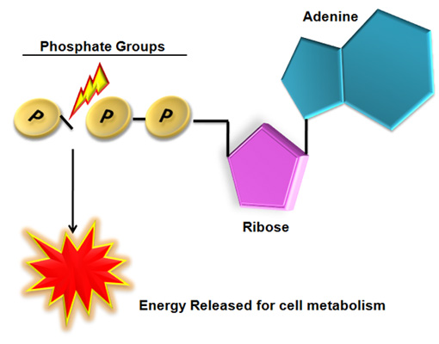
Na+-K+- ATPase
The enzymatic function :
alpha subunit, contains the binding sites for: ATP
The beta subunit
serves as a chaperone molecule
to facilitate the
Insertion of the alpha subunit in the plasma membrane.
modulates the affinity of Na+-K+- ATPase for cations
ATP

Slide 6
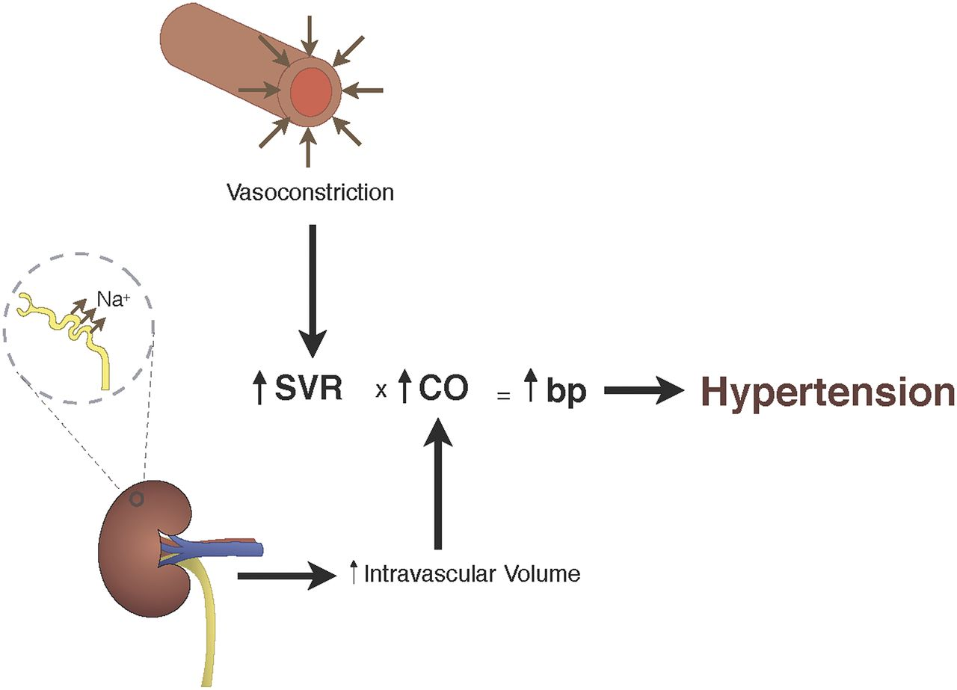
NA+K+ATPase
Present in all cells:
Endothelial cells alpha 1 subunit
Smooth muscle cells alpha 1 subunit
Adrenergic nerves
Myocardial muscle
Skeletal muscle
Brain
Na-K-ATPase
important effects on the
Contractile state of vascular smooth muscle,
Influence:
blood flow
and blood pressure .

Slide 7
NA+K+ATPase
Depolarized skeletal muscle cells :Release Potassium into the Interstitial space surrounding the arterioles
stimulates the Na-K pump in the vascular smooth muscle cells
Hyperpolarization of the cells
Reduced calcium influx
Relaxation and Dilatation of the Arteriole

Slide 8
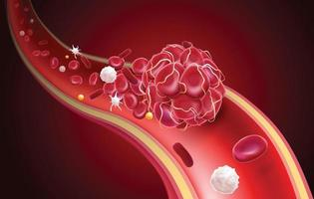
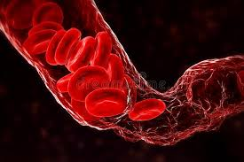
Relaxation and Dilatation of the Arteriole
Lowering the Potassium concentration in blood
Increased blood flow
vasoconstriction
1-stimulation of Na-K-ATPase in:
vascular smooth muscle cells
adrenergic nerve terminals,
vasodilatation .
Dietary potassium supplementation potentiates endothelium-dependent relaxation .
in the setting of Hypokalemia
Upregulated Renin Angiotensin System
. Semin Nephrol 2013; 33:277.
. Am J Physiol Endocrinol Metab 2017; 312:E348
J Physiol 2019; 597:4451.

Slide 9
Hypokalemia
causes
Vascular calcification
promotes Arterial Stiffness
through induction of autophagy and
promotion of vascular smooth muscle calcification
. Semin Nephrol 2013; 33:277.
. Am J Physiol Endocrinol Metab 2017; 312:E348
J Physiol 2019; 597:4451.

Slide 10
Kir channels
The inward rectifier family of potassium channels
= Channel conducts potassium current more readily in the cells
seven subfamilies (Kir1.0 to Kir7.0)
the Kir2.0 =to the blood vessel wall.

Slide 11
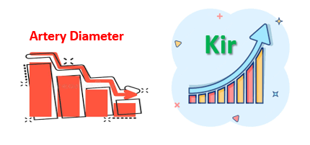
In the vascular wall
Kir channels are expressed in
Endothelial
Smooth muscle cells.
artery
Expression of the Kir channel appears to Increase as
the diameter of the artery decreases
Abundant in the
Smooth muscle of auto regulatory vascular beds such as the
Coronary
Cerebral circulations .
In the general circulation,

Slide 12
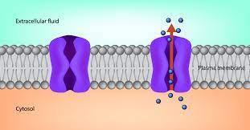
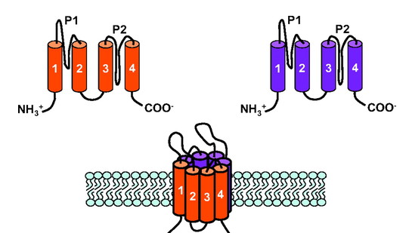
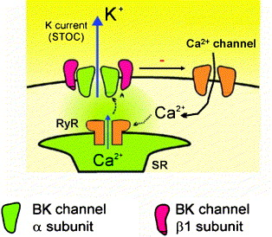
Potassium channels are classified in four subgroups
the voltagegated (KV)
the calcium-activated (KCa)
The large-conductance, calcium-activated potassium channels (BK, also termed BK_{Ca}, Slo, or MaxiK)
the two-pore-domain (K2P)
Kir channels The inward rectifier family of potassium channels
= channel conducts potassium current more readily in the cells
seven subfamilies (Kir1.0 to Kir7.0)
the Kir2.0 =to the blood vessel wall.
in the systemic or pulmonary circulations. VSMCs, endothelial cells.

Slide 13
Dietary intake of potassium and HTN

Slide 14
Low-potassium diet
Low dietary potassium intake (below 40 mEq/day [1.5 g/day]) has been associated with:
an elevation in blood pressure
an increased risk of stroke
an increase in risk of chronic kidney disease
Araki S, Haneda M, Koya D, et al. Urinary Potassium Excretion and Renal and Cardiovascular Complications in Patients with Type 2 Diabetes and Normal Renal Function.
Clin J Am Soc Nephrol 2015; 10:2152.

Slide 15

Low-potassium diet
In different studies:
in healthy normotensive men
in patients with primary hypertension (formerly called essential hypertension)
Potassium restriction:
from a normal intake of 80 to 90 mEq/day
down to 10 to 18 mEq/day
significant 4 to 5 mmHg Increase in Systolic blood pressure.
may have been mediated in part by sodium retention.
Systolic blood pressure.
O'Donnell MJ, Yusuf S, Mente A, et al. Urinary sodium and potassium excretion and risk of cardiovascular events. JAMA 2011; 306:2229.
2. Green DM, Ropper AH, Kronmal RA, et al. Serum potassium level and dietary potassium intake as risk factors for stroke. Neurology 2002; 59:314.
3 Araki S, Haneda M, Koya D, et al. Urinary Potassium Excretion and Renal and Cardiovascular Complications in Patients with Type 2 Diabetes and Normal Renal Function.
Clin J Am Soc Nephrol 2015; 10:2152.

Slide 16

High-potassium diet
Lowers the Blood pressure Significantly in: Hypertensive patients
insignificantly in normotensive patients. (0.1/0.6 mmHg)
Lowers the Blood pressure
5.3/3.1 mmHg.
5.3/3.1 mmHg.
An increase Potassium diet to:
90 to 120 mEq/day had:
the Largest Reduction in blood pressure (7.2/4.1 mmHg)
Aburto NJ, Hanson S, Gutierrez H, et al. Effect of increased potassium intake on cardiovascular risk factors and disease: systematic review and meta-analyses. BMJ 2013;

Slide 17
In a meta-analysis of 11 cohort studies
High-potassium diet
250,000 individuals,
a 1.64 g (42 mmol)/day higher potassium intake
21 percent:
Lower Risk of Stroke
D'Elia L, Barba G, Cappuccio FP, Strazzullo P. Potassium intake, stroke, and cardiovascular disease a meta-analysis of prospective studies. J Am Coll Cardiol 2011; 57:1210.

Slide 18
Black patients: the effect of potassium supplementation on blood pressure
in Black patients Less Urinary potassium excretion than in White patients .
is due in part to
Less dietary potassium intake
Increase in the Activity of the Na-K-2Cl cotransporter in the luminal membrane in the thick ascending limb of the loop of Henle
This defect could contribute to :
the Decreased plasma renin activity,
Lower rate of urinary potassium excretion,
and Increased salt sensitivity often seen in Black patients
Turban S, Miller ER 3rd, Ange B, Appel LJ. Racial differences in urinary potassium excretion. J Am Soc Nephrol 2008; 19:1396.
Aviv A, Hollenberg NK, Weder A. Urinary potassium excretion and sodium sensitivity in blacks. Hypertension 2004; 43:707.

Slide 19
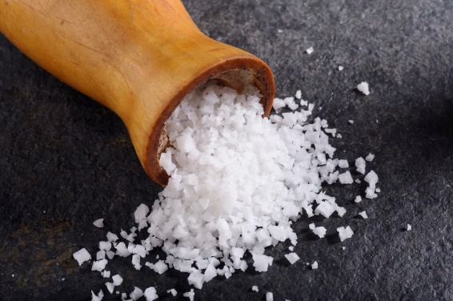
The ratio of Dietary
Sodium-to-Kotassium
&
HTN

Slide 20
The ratio of dietary sodium-to-potassium
Influence Blood Pressure
each three-unit increase in the urine sodium-to-potassium ratio, which can reflect increased sodium intake and/or reduced potassium intake,
was associated with a
1.6/1 mmHg elevation in blood pressure.
an increase in overall cardiovascular mortality
Dallas Heart Study,
Roughly 1:3
potassium intake would ideally be around three times our sodium intake.
Burnier M. Should we eat more potassium to better control blood pressure in hypertension? Nephrol Dial Transplant 2019; 34:184.
Castro H, Raij L. Potassium in hypertension and cardiovascular disease. Semin Nephrol 2013; 33:277.

Slide 21
Clinical implications

Slide 22
Clinical implications
Hypertensive patients with Normal or near-normal kidney function
Encouraged to maintain a high potassium intake from
fresh fruits and vegetables
Dietary counseling
Adrogué HJ, Madias NE. Sodium and potassium in the pathogenesis of hypertension. N Engl J Med 2007; 356:1966.

Slide 23

Clinical implications
Potassium chloride supplements can also be used
if the serum potassium concentration is low.
However, if there is No apparent cause for the hypokalemia
(eg, diuretic therapy, gastrointestinal losses),
should be evaluated for :
both hypertension and hypokalemia.
Primary aldosteronism
Renovascular disease
Cushing's syndrome

Slide 24
National Health and Nutrition Examination Survey (NHANES) III
The average daily potassium intake in adults was :
in men : 74 to 82 mEq (2.9 to 3.2 g)
in women: 54 to 59 mEq (2.1 to 2.3 g)
10 percent of men
less than 1 percent of women
had a daily potassium intake of
120 mEq (4.7 g) or more.
Appel LJ, Giles TD, Black HR, et al. ASH position paper: dietary approaches to lower blood pressure. J Am Soc Hypertens 2010; 4:79.

Slide 25

We do not recommend
Potassium supplementation
or a High-potassium diet
in patients at Risk for Hyperkalemia:
Therapy with angiotensin inhibitors
Potassium-sparing diuretics
Chronic kidney disease

Slide 26
Relation to Sodium Excretion
Diminished by
hypokalemia
low-potassium diet
Increased with
potassium supplements
apparently through changes in sodium reabsorption in the proximal tubule and/or loop of Henle

Slide 27
Dietary sodium excess
In normal human subjects
Increases urinary Potassium excretion
a small fall in plasma potassium concentration.
Blood pressure also Increases,
and this can be attenuated by dietary potassium supplementation .

Slide 28
Role of chloride intake
Chloride is an important determinant of the rise in blood pressure in salt-sensitive forms of hypertension.
By comparison, dietary potassium
(eg, from fruits and vegetables) is primarily associated with organic anions such as citrate, not chloride
He FJ, Markandu ND, Coltart R, et al. Effect of short-term supplementation of potassium chloride and potassium citrate on blood pressure in hypertensives. Hypertension
2005; 45:571.
. He FJ, Marciniak M, Carney C, et al. Effects of potassium chloride and potassium bicarbonate on endothelial function, cardiovascular risk factors, and bone turnover in mild
hypertensives. Hypertension 2010; 55:681.

Slide 29
Potassium supplementation
Bicarbonate
Citrate
Chloride
a similar reduction in blood pressure.
Thus, the available evidence does not support
the accompanying anion being important in the effect of potassium on blood pressure.

Slide 30
Take Home Messages
Maintenance of adequate potassium intake
or the administration of potassium supplement
usually lowers the blood pressure,
Furthermore,
a higher potassium intake reduces the risk of stroke.
Some experts suggest that hypertensive patients should consume at least :120 mEq (4.7 g) of dietary potassium/day provided they do not have a predisposition to hyperkalemia.

Slide 31
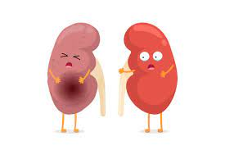
Take Home Messages
average daily potassium intake of roughly 2 g be increased to about 5 g .
This seems appropriate in the management of hypertension and the prevention of stroke,
but excessive potassium intake should be Avoided, particularly in the
presence of Renal disease.

Slide 32
On a background of poor renal function
Take Home Messages
Also Patients receiving
angiotensin-converting enzyme (ACE) inhibitors
or ANG II receptor antagonists,
particularly when combined with an aldosterone blocker,,
sometimes become Hyperkalemic.

Slide 33

Thank You

